Slide 1
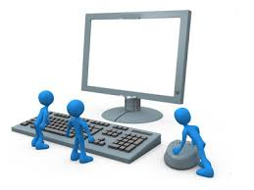
Introduction
to
Computers

Slide 2

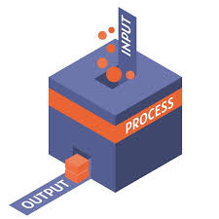

What is a computer ?
Electronic device that takes input from the user and performs a task
Process the code, make decisions , perform calculations etc
Gives the output by displaying or saving a file or plays music etc

Slide 3
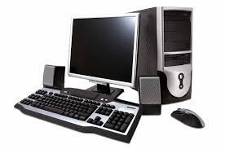


What is a computer ?
Consists of both hardware (physical) and software(Programs)
Can perform various tasks from simple calculations to colmplex operations
Can store, retrieve and process data

Slide 4



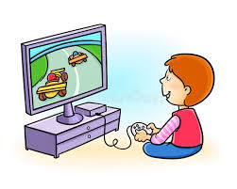


Uses of computers
Watching videos
Browse the internet
Writing Documents.
Playing games
Shop online
Manage accounts

Slide 5

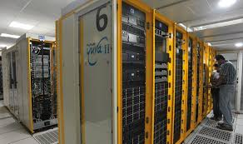
Based on size
Mainframe computers
Super computers
Types of computers
Used by very large organizations
Used to manage bulk data
Functions include managing customer statistics, census data etc
Example : Banks, Insurance companies, database management
Most powerful computers in terms of processing power
Used for extremely complex computations like weather forecasting
Can perform billions of calculations per second
Very costly and require temperature controlled environment

Slide 6
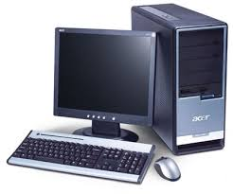
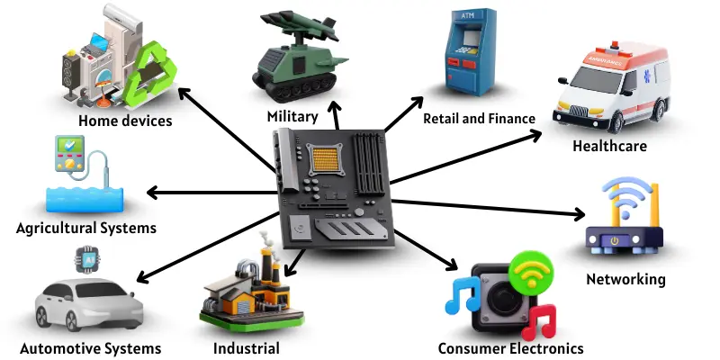
Based on size
Micro computers
Embedded computers
Types of computers
Most common type of computers used by individuals
Designed for general purpose tasks
Found in homes, schools and offices
Used for browsing the internet, word processing, gaming etc.
Based on a micro processor which integrates the functions of a computer.
Specialized computers designed to perform specific tasks
Often built into other devices
Used in house hold appliances, industrial machines etc
Smart TV, Washing machines, car controls , Microwave ovens.

Slide 7
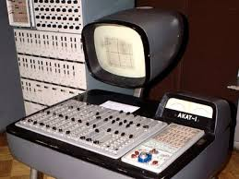
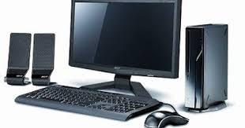
Based on functionality
Analog computers
Digital computers
Types of computers
Designed to process continuous data
Uses physical quantities such as voltage , current to represent data.
Used for tasks that require real-time simulations.
Used in scientific research, engineering and control system
Used in Speedometers, thermometers, Radar systems
Process data in binary form 0s and 1s
Most common type of computer
Capable of performing arithmetic and logical operations
Used in personal computers , servers, smart phones etc.
.

Slide 8
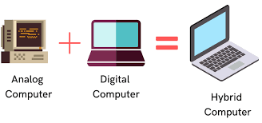
Based on functionality
Hybrid computers
Types of computers
Combine the features of both Analog and digital computers.
Can process both continuous (analog) as well as digital data .
Highly useful in specifc applicaions where both types of data need to be processed. simultaneously.
Used in Hospitals(patient monitoring systems), scientific research ( temperature recording system) and industries

Slide 9
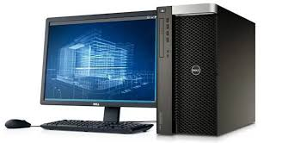
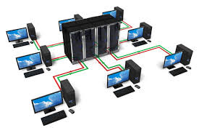
Based on performance
Workstations
servers
Types of computers
High performance computers that require greater processing power.
Contain high performance processes (mutli-core or Multi-threaded).
Used for 3 D graphics rendering, video editing, CAD etc
used by engineers, designers, architects, scientists, architects for performing complex tasks.
Specialized computers designed to manage, store, provide resources to other computers (client)
High processing power to handle multiple requests and manage extensive data.
Built for high availability and reliability, often operating 24/7 without interruption.
Provide services such as web hosting, file sharing, database management, and email hosting.

Slide 10
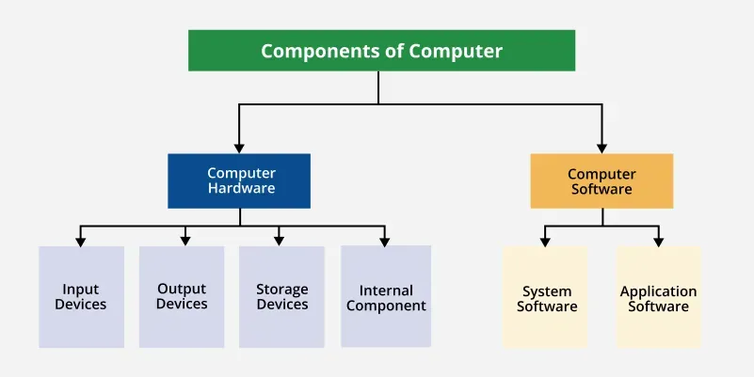
Anatomy of a computer

Slide 11
The Hardware
Physical devices that can be seen and touched like CPU, Keyboard, Monitor etc
Further divided into
Input Devices
Output Devices
Storage Devices
Internal components

Slide 12
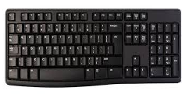
Allows the users to interact with a computer by entering data or commands.
Keyboard.
Input Devices
Used to enter text, Numbers and commands.
Consists of 104 keys
Follows QWERTY layout
Also includes navigation arrows and functions
Can connect via Bluetooth.

Slide 13
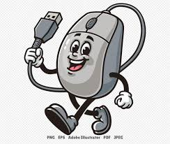
Mouse
Hand held device used to control the movement of the cursor.
Allows the user to interact with graphical user interface (GUI)
Moving the mouse on a surface causes the cursor to move in the same direction.
Pressing the mouse buttons (usually left and right) performs actions like selecting items, opening files or programs, or activating commands
Input Devices

Slide 14
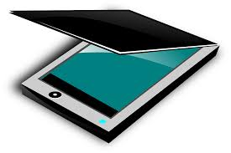
Scanner
Used to convert physical documents, images, etc into digital format that can be used in a computer..
Captures the document or image by reflecting light off its surface and translates into a series of binary code.
Input Devices

Slide 15

Microphone
Converts sound waves into electrical signals, allowing the user to record audio or communicate through voice.
Many Laptops and desktops contain built-in microphones.
Microphones are also used convert spoken words into text for documents or email.
Input Devices

Slide 16
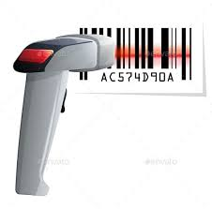
Barcode reader
Electronic input device that reads data encoded in a bar code and transmits to a computer.
Uses a light source to scan the barcode and lens to focus the reflected light.
The light sensor detects the reflected light pattern
Decoder interprets the electrical signals from sensor and translates into digital data.
Input Devices

Slide 17
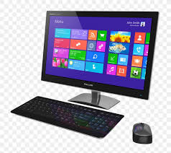
Display the results of the tasks given to a computer in a human readable format .
Monitor
Output Devices
Main output device also called as Visual Display Unit (VDU)
Looks like a TV screen
Displays the information from the computer
Can vary in size, resolution and technology used
(LED, LCD etc)

Slide 18
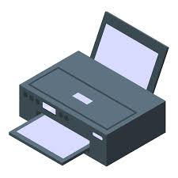
Printer
Produces a physical copy (hard copy) of the electronic data (text, images etc) from a computer.
Connects to a computer allowing users to print text, graphics or other data onto a paper
Can connect via USB , Wi-Fi or other network connections
Various types are available (inkjet, laser printers, 3-D printers etc
Output Devices

Slide 19
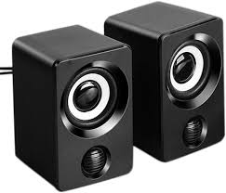
Speakers
Output device that converts electrical signals into audible sounds.
Essential for playing music, videos, games and other multi media content
Can be built-in to a computer often found in laptops and in some all-in-one desktops.
Output Devices

Slide 20
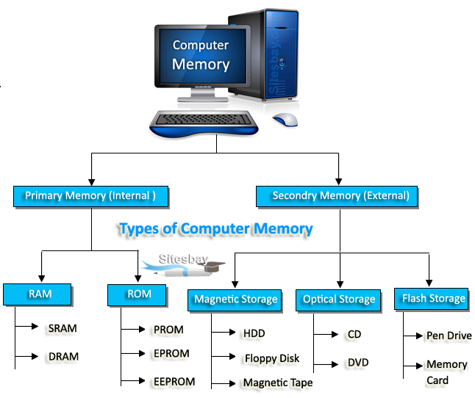
Computer memory
Computer memory often refers to the physical device used to store data or program instructions either temporarily or permanently
It allows the CPU to quickly access the data and process it.
Types of memory
Primary memory
2. Secondary memory
3. Cache memory
4. Register memory
Computer Memory

Slide 21
Primary Memory
Also known as the main memory.
Stores current data , programs and instructions
Can be built-in to a computer often found in laptops and in some all-in-one desktops.
It has limited capacity and data will be lost when the computer is switched off.
Directly accessed by CPU
Two sub categories
a) RAM b) ROM
Computer memory

Slide 22
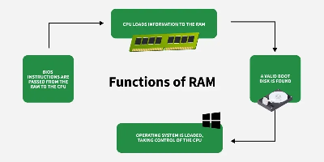
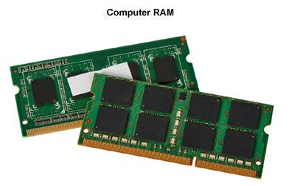
RAM
Acronym for Random Access Memory.
Present in the motherboard
Helps the computer to run programs and process information faster.
Speed of the device depends upon capacity of the RAM
It has limited capacity and data will be lost when the computer is switched off.
Two categories
a) DRAM b) SRAM
Computer Memory

Slide 23

RAM
Computer Memory

Slide 24
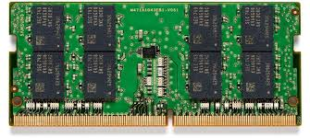
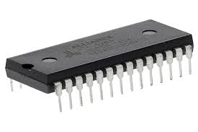
RAM
DRAM
SRAM
Computer Memory
Stands for Dynamic Random Access Memory
Most common type of RAM used in main memory.
DRAM stores each bit of data in a capacitor paired with a transistor.
Data bits are stored as Charged = 1 and Discharged =0
Must be refreshed frequently since the capacitors leak.
Stands for Static Random Access Memory
holds data as long as power is supplied, without the need for refreshing.
Much faster than DRAM
Each bit in SRAM is stored using a flip-flop circuit made from 6 transistors..
The flip-flop maintains the bit's state (0 or 1) indefinitely as long as power is supplied.

Slide 25
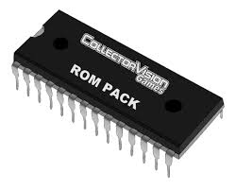
ROM
Acronym for Read Only Memory.
It is a type of non-volatile memory that means it retains its data even when the computer is switched off.
Mostly read only --- Typically written and once rarely changes. .
Used to store firmware - Permanent software instructions that help the computer to boot and manage hardware.
Computer memory

Slide 26
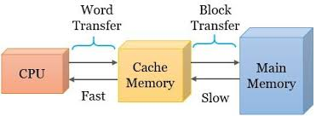
Cache memory
Small high speed memory unit located close to the CPU
Stores frequently accessed data and instructions so that the CPU can retrieve them quickly
It is faster than RAM
bridges the speed gap between the ultra-fast CPU and slower RAM.
Modern CPUs have multiple levels of cache
L1 – Inside CPU (fastest)
L2 – On the same chip (Very fast)
L3 – O chip or on a die(slower than L1 and L2)
Computer memory

Slide 27
Register memory
Small set of storage locations inside CPU
Holds data, addresses or instructions that the processor is currently using.
Fastest type of memory used by the CPU for immediate data processing.
Used to store immediate results of calculations.
Hold memory addresses to accessRAM
Critical for CPU operations , without them CPU can’t perform any tasks.
Memory Devices

Slide 28
Register memory – Common types
Register Name | Purpose
Accumulator (ACC) | Stores results of arithmetic/ logical operations
Program counter (PC) | Holds the address of the next instruction to be executed
Instruction Register (IR) | Stores the current instructions being executed.
Memory Address Register (MAR) | Holds the address of data to be fetched from RAM
Memory Data Register (MDR) | Holds data fetched from or to be written to memory
General Purpose Register | Used for storing temporary data / variables
Memory Devices

Slide 29
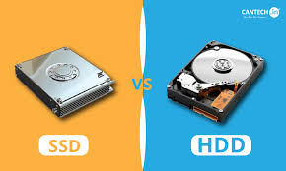
Secondary memory
Stores data prermanently
Not directly accessed by CPU
Types
Magnetic Storage Devices
a. Hard disk drives
Most commonly type of secondary memory
Uses spinning magnetic platters and read / write heads.
high capacity and low cost.
Slower and prone to failure
b. Floppy Disks
Used in old pcs
2. Solid state storage devices
a. Solid state drives (SSD)
Uses Flash memory with no moving parts
Much faster than HDD in data transfer
Fast, durable and efficient
More expensive.
Storage Devices

Slide 30
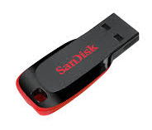
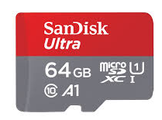
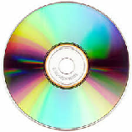
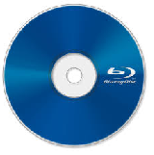
Secondary memory
b. USB Flash Drives (pen drives)
Portable
Plug and play via USB.
high capacity and low cost.
Slower and prone to failure
c. Memory cards
Very small in size
Used in cameras, Mobile phones, drones etc
3. Optical storage
Uses Lasers to read / write date
a. Compact disk: common for simple data backup and music
b. DVD (Digital Versatile Disk) : used for videos and software distribution
c. Blu Ray Disc : Suitable for HD movies and large data storage
High capacity (25 GB to 100 GB).
Storage Devices

Slide 31

Secondary memory
4. Cloud storage
Data stored on remote servers
Accessible via internet
Scalable and accessible from anywhere
Depends on internet connectivity
Output Devices

Slide 32
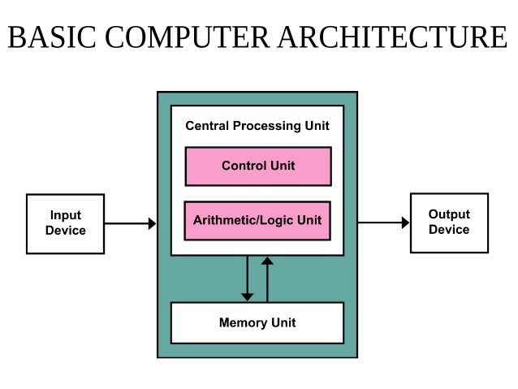
Architecture of a computer

Slide 33
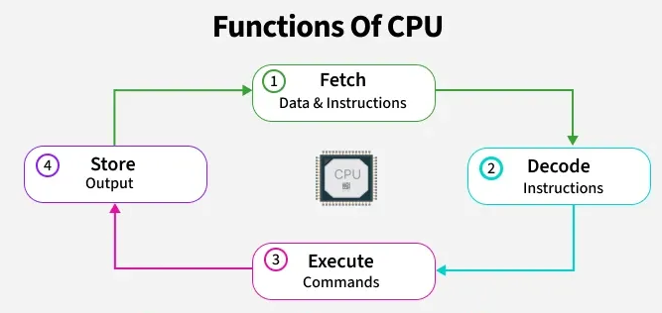
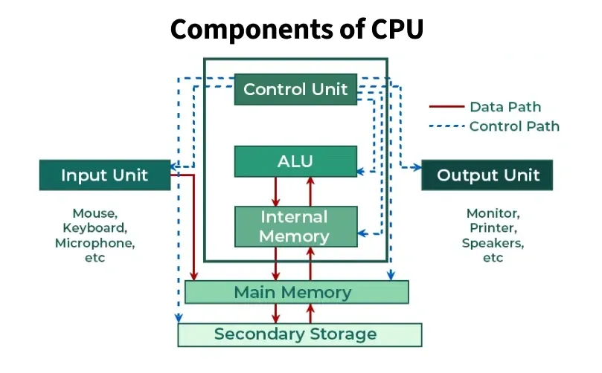
The central Processing Unit
Main component of the computer that performs most of the processing tasks.
Carries out instructions from the programs by performing basic arithmetic, logic, control, input and output operations.
Without CPU a computer can do nothing
The components of CPU includes
Arithmetic and logic unit(ALU)
Control Unit (CU)
Registers, cache and clock

Slide 34
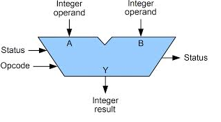
Arithmetic and logic unit
Performs arithmetic operations (add, subtract, multiply, divide)
Performs logical operations that involves decision making (AND, OR ,NOT, comparison operations ).
Works in coordination with Registers to store operands and results temporarily
Works with control Unit to provide control signals for operaton selection.
Works with Data Bus to read and write data from / to memory.

Slide 35
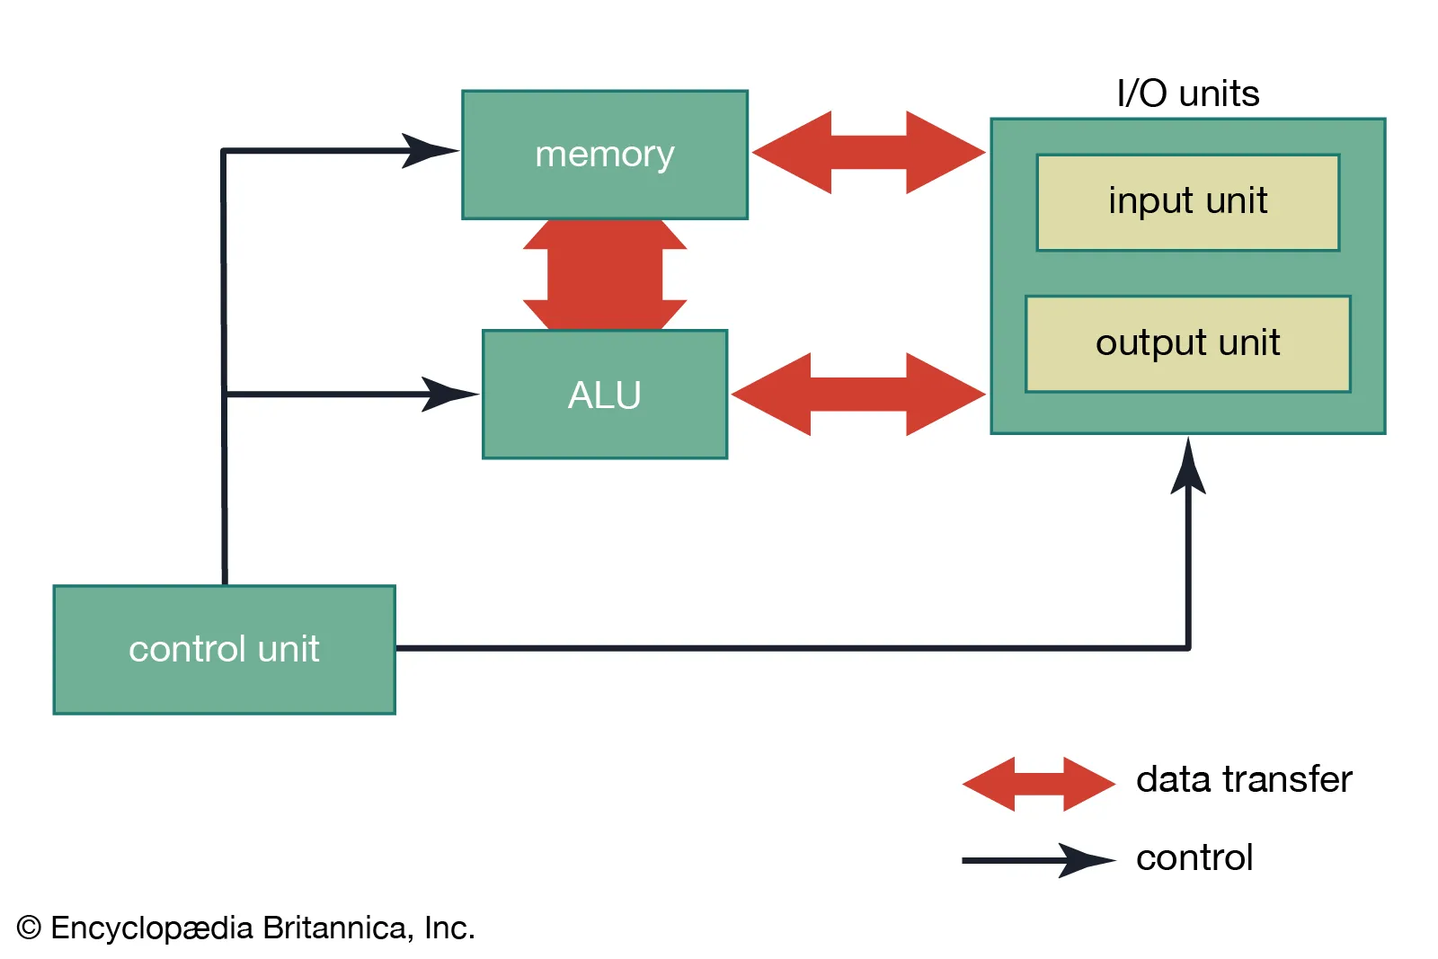
The control Unit
Manages and coordinates all operations inside the computer
It acts like the "manager" or "traffic controller" of the CPU.
Tells the computer’s parts what to do, when to do it,
and how to do it.
How it works ADD 10, 20
Fetch the instruction from memory
Decode it (realize it needs to add contents of 10 and 20)
Signal the ALU to perform addition
Signal where to store the result (e.g., in register A)
Update the Program Counter to the next instruction

Slide 36
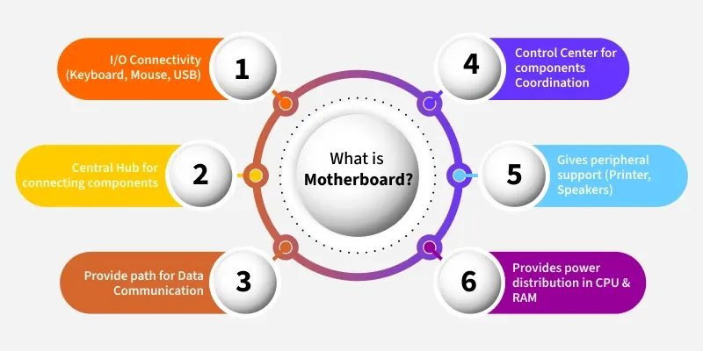
The mother board
It is the main circuit board inside the computer.
It holds the processor (CPU), memory (RAM), hard drives, and other parts, letting them share information and power
Acts like a team captain, making sure every part does its job.

Slide 37
Components of a
mother board
CPU SOCKET :
CPU is installed in this space.
Servers as a connector between the mother board and microprocessor
Makes the CPU easier to operate
Connects the CPU with other components through chipsets and buses.
CHIP SET
Acts as a communication hub between the mother board other peripherals
Consists of Northbridge which handles the communication between CPU, RAM and GPU
Southbridge manages I/O, USB and SATA
Modern motherboards the chipset is a single set which manages all these functions.

Slide 38
Components of a
mother board
CPU SOCKET :
CPU is installed in this space.
Servers as a connector between the mother board and microprocessor
Makes the CPU easier to operate
Connects the CPU with other components through chipsets and buses.
CHIP SET
Acts as a communication hub between the mother board other peripherals
Consists of Northbridge which handles the communication between CPU, RAM and GPU
Southbridge manages I/O, USB and SATA
Modern motherboards the chipset is a single set which manages all these functions.

Slide 39
Components of a
mother board
MEMORY SLOTS :
Hold RAM modules.
Most boards have 2 to 8 slots
EXPANSION SLOTS
Allow additional cards like graphic cards, sound cards, and network cards
STORAGE INTERFACES
Connect HDDs SSDs and optical drives
INPUT / OUTPUT PORTS
Ports include USB ports, HDMI /VGA ports, Ethernet port, Audio jacks

